Slide 1
PRINCIPLE OF MATHEMATICAL INDUCTION To prove that P(n) is true for all positive integers n, where P(n) is a propositional function, we complete two steps:
BASIS STEP: We verify that P(1) is true.
INDUCTIVE STEP: We show that the conditional statement P(k) → P(k + 1) is true for all positive integers k.
INTERMS OF Rules of inference
(P (1) ∧ ∀k(P(k) → P(k + 1))) → ∀nP (n),
Copyright © by Houghton Mifflin Company, Inc. All rights reserved.

Slide 2
Definition: Mathematical Induction
Mathematical induction is a legitimate method of proof for all positive integers n.
Principle:
Let P(n) be a statement involving n, a positive integer. If
1. P(1) is true, and
2. the truth of P(k) implies the truth of P(k+1) for every positive k,
then P(n) must be true for all positive integers n.
Copyright © by Houghton Mifflin Company, Inc. All rights reserved.

Slide 3
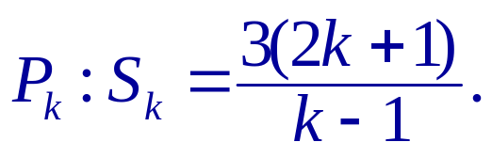
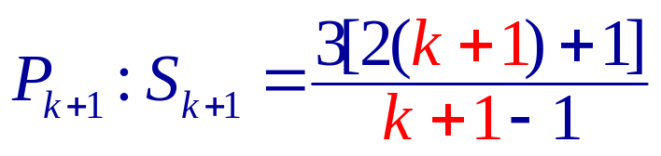
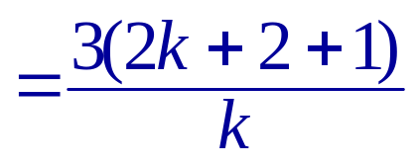
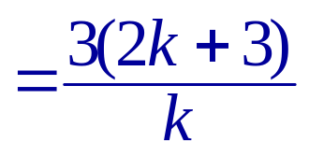
Example: Find P_{k+1}
Example:
Find P(k+1) for
Replace k by k + 1.
Simplify.
Simplify.
Copyright © by Houghton Mifflin Company, Inc. All rights reserved.

Slide 4
Example: Using Induction to Prove a Summation
Example:
Use mathematical induction to prove
S_{n} = 2 + 4 + 6 + 8 + . . . + 2n = n(n + 1)
for every positive integer n.
1. Show that the formula is true when n = 1.
S₁ = n(n + 1) = 1(1 + 1) = 2
True
2. Assume the formula is valid for some integer k. Use this assumption to prove the formula is valid for the next integer, k + 1 and show that the formula S_{k + 1} = (k + 1)(k + 2) is true.
S_{k} = 2 + 4 + 6 + 8 + . . . + 2k = k(k + 1)
Assumption
Example continues.
Copyright © by Houghton Mifflin Company, Inc. All rights reserved.

Slide 5
Example Continued
Example continued:
S_{k + 1} = 2 + 4 + 6 + 8 + . . . + 2k + [2(k + 1)]
= 2 + 4 + 6 + 8 + . . . + 2k + (2k + 2)
= S_{k} + (2k + 2)
Group terms to form S_{k}.
= k(k + 1) + (2k + 2)
Replace S_{k} by k(k + 1).
= k² + k + 2k + 2
Simplify.
= k² + 3k + 2
= (k + 1)(k + 2)
= (k + 1)((k + 1)+1)
The formula S_{n} = n(n + 1) is valid for all positive integer values of n.
Copyright © by Houghton Mifflin Company, Inc. All rights reserved.

Slide 6
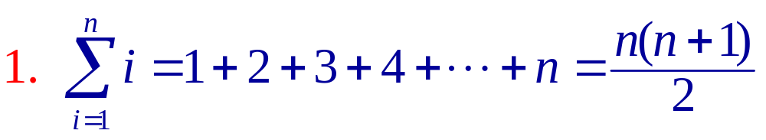
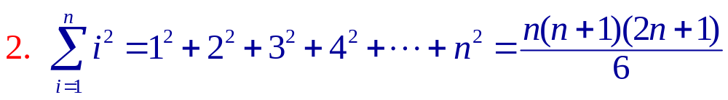
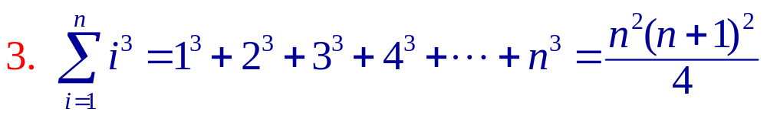
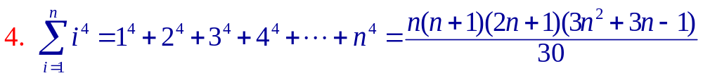
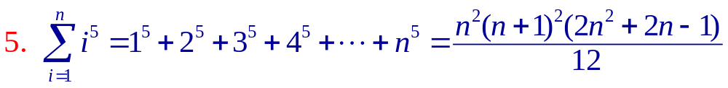
Sums of Powers of Integers
Sums of Powers of Integers :
Copyright © by Houghton Mifflin Company, Inc. All rights reserved.

Slide 7
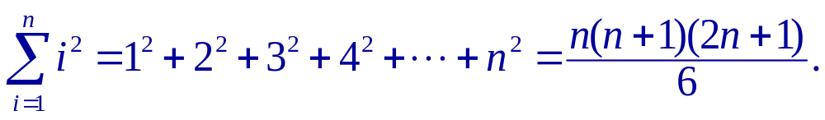
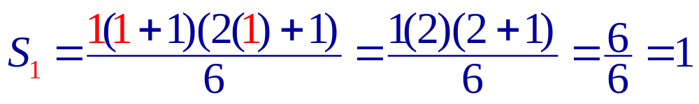
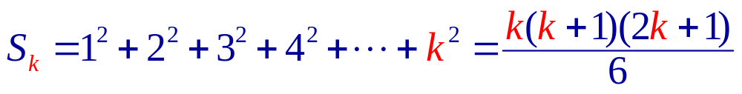
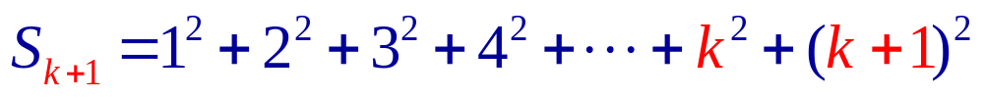
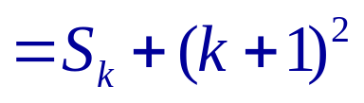
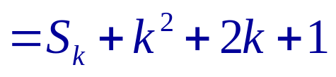
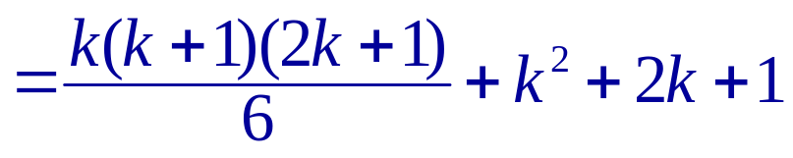
Example: Using Induction to Prove Sum of Power
Example:
Use mathematical induction to prove for all positive integers n,
True
Assumption
Group terms to form S_{k}.
Replace S_{k} by k(k + 1).
Example continues.
Copyright © by Houghton Mifflin Company, Inc. All rights reserved.

Slide 8
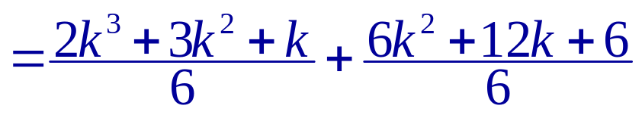
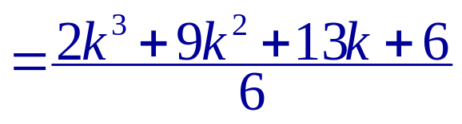
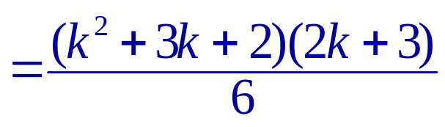
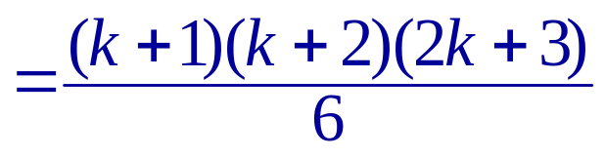
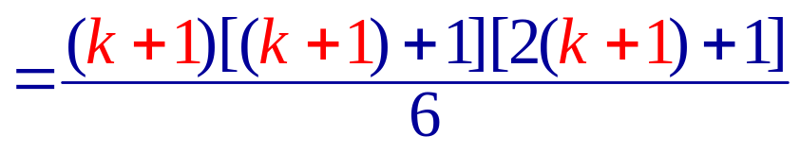
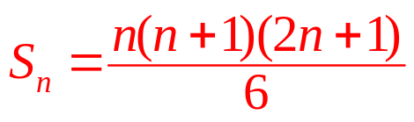
Example Continued
Example continued:
Simplify.
The formula is valid for all positive integer values of n.
Copyright © by Houghton Mifflin Company, Inc. All rights reserved.

Slide 9
Finite Differences
Finite Differences
The first differences of the sequence 1, 4, 9, 16, 25, 36 are found by subtracting consecutive terms.
n: 1 2 3 4 5 6
a_{n}: 1 4 9 16 25 36
First differences:
3
5
7
9
11
Second differences:
2
2
2
2
quadratic model
The second differences are found by subtracting consecutive first differences.
Copyright © by Houghton Mifflin Company, Inc. All rights reserved.

Slide 10
Quadratic Models
When the second differences are all the same nonzero number, the sequence has a perfect quadratic model.
Find the quadratic model for the sequence
1, 4, 9, 16, 25, 36, . . .
a_{n} = an² + bn + c
a₁ = a(1)² + b(1) + c = 1
a + b + c = 1
a₂ = a(2)² + b(2) + c = 4
4a + 2b + c = 4
a₃ = a(3)² + b(3) + c = 9
9a + 3b + c = 9
Solving the system yields a = 1, b = 0, and c = 0.
a_{n} = n²
Copyright © by Houghton Mifflin Company, Inc. All rights reserved.

Slide 11
Example: Find the Quadratic Model
Example:
Find the quadratic model for the sequence with
a₀ = 3, a₁ = 3, a₄ = 15.
a_{n} = an² + bn + c
a₀ = a(0)² + b(0) + c = 3
a₁ = a(1)² + b(1) + c = 3
a₄ = a(4)² + b(4) + c = 15
c = 3
a + b + c = 3
Solving the system yields a = 1, b = –1, and c = 3.
16a + 4b + c = 15
a_{n} = n² – n + 3
Copyright © by Houghton Mifflin Company, Inc. All rights reserved.

